Slide 1

Application to help color blind patients

Slide 2
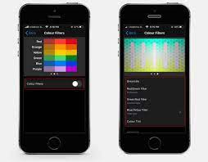
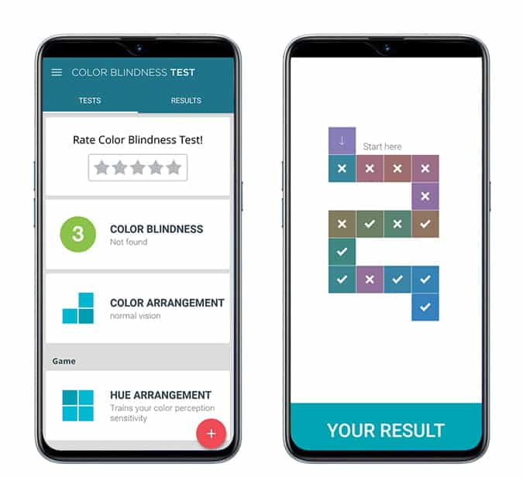
We are working on developing a (humane application) to help (color blind patients) in (distinguishing between colors) through (technology intervention).

Slide 3
Problems
Difficulty distinguishing colors: People with color blindness have difficulty distinguishing some colors or differentiating between them. They may be unable to distinguish between red and green or blue and yellow, which affects the ability to interact with certain environments or understand certain color-based signs and signals.
Challenges in daily life: Patients with color blindness face challenges in daily life, such as driving cars or choosing clothes appropriately. They may need to rely on alternate color codes or other cues to deal with these difficulties and adapt to the environment around them.

Slide 4
The Solutions
Color identification: The application provides tools to easily identify and distinguish colors, whether by using the camera to analyze surrounding colors or by entering color values manually. This helps users to distinguish between colors and better understand their details.
Providing alternative colors: The application includes a set of alternative colors that can be used instead of colors that are difficult for color blind patients to distinguish. Users can choose the appropriate colors from this collection and apply them in designs, clothes, and decorations.
Tips and advice for design and color choices: The app provides practical advice and guidance for users to deal with the difficulties of color vision in everyday life. Users can benefit from tips on color coordination in clothes, room design, and graphics, which helps them make decisions

Slide 5
Market Opportunity
$ 1.5. B
Total Addressable. Market
User growth: The rising number of patients with color blindness is an important application market opportunity. With increasing awareness of the disorder and early diagnosis, the demand for assistive tools and applications to improve patients' lives and enable them to interact better in daily and professional life increases.
$=$ 500 M
Serviceable. Addressable Market
Lack of competition: There may be an opportunity for application due to the lack of competition in this particular domain. If there is a lack of available applications to help color blind patients or provide appropriate services, this opens the door to developing a unique and comprehensive application that meets the needs of users and gives them a better experience.

Slide 6
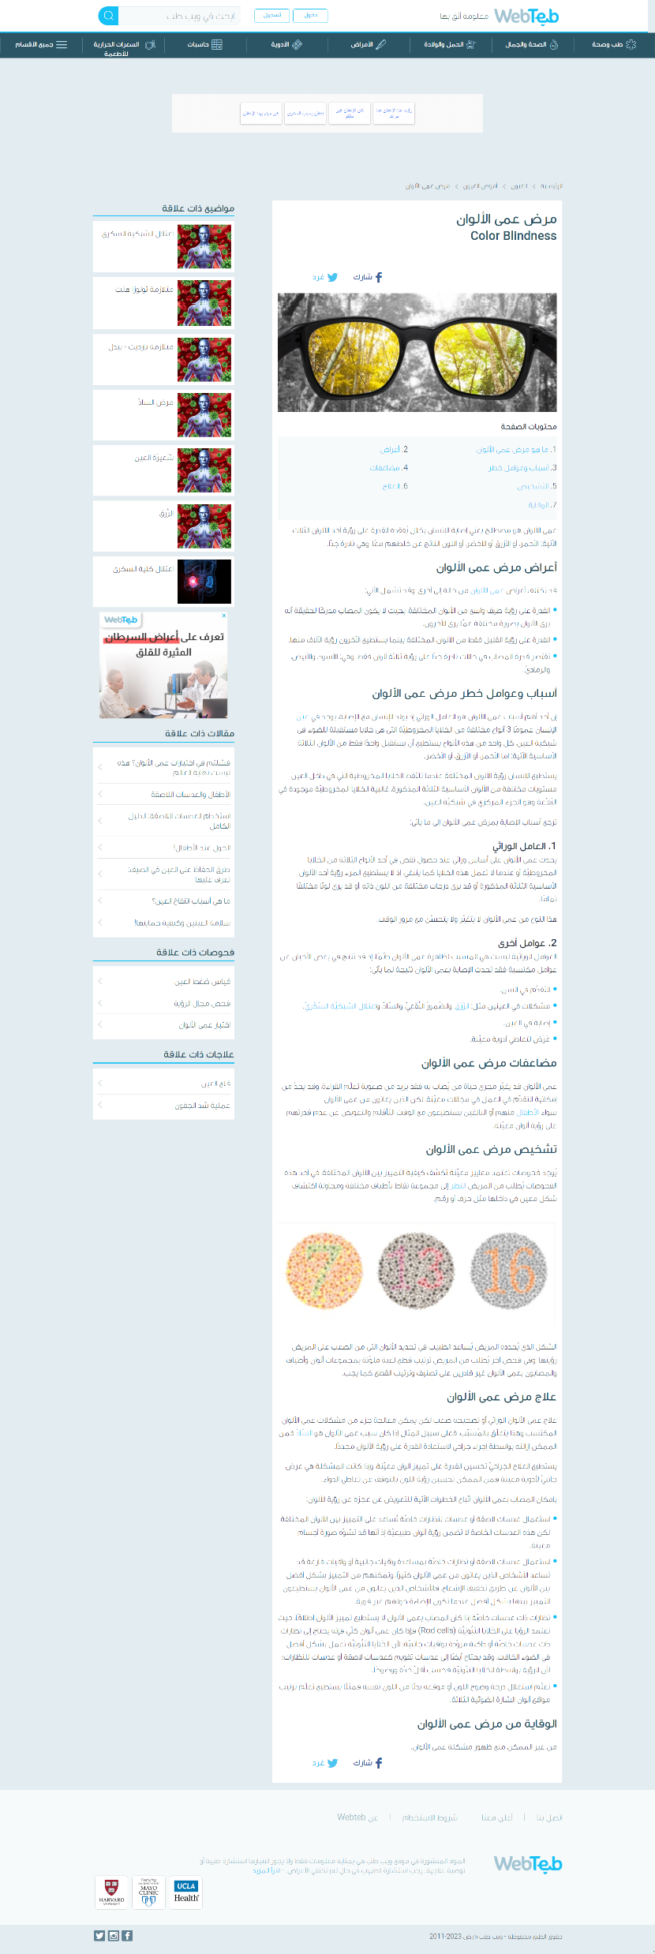
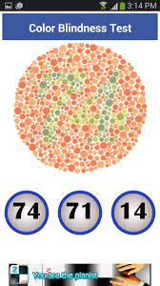
Your Product in details
The website for color blind people aims to provide useful information and tips for coping with the disorder, as well as tools and apps for identifying appropriate colors in everyday life. The site serves as a comprehensive and reliable reference that contributes to community awareness and promotes understanding and empathy for color blindness patients.
Web Version
An application to help patients with color blindness aims to facilitate the lives of users and enhance their interaction with the world, by specifying colors and providing alternative colors and tips for design, which contributes to improving the quality of their lives and increasing their ability to participate with confidence in society.
Mobile Version

Slide 7



Competitive Landscape
Application Integration | 85% | 77% | 95% | 50%
Ease of use | very easy | natural | complex | natural
User reputation and ratings | A new application | A new application | Popular and popular application | Unused application

Slide 8
Business Model
Providing an app that helps people with color blindness can be valuable to users, and here are some potential ways to earn income from this app:
Ads: You can earn revenue by displaying ads in the app. You may collaborate with advertising companies to display targeted advertisements about eye health or related products and services.
Subscriptions: You may offer a monthly or yearly subscription model to users who wish to access advanced features or exclusive content within the application.
3. Cooperation with companies: You can negotiate with other companies to cooperate and provide customized services for patients through the application, such as color design advice or a guide to products and brands suitable for color blind people.

Slide 9
Financial Projection
 | Q1 | Q2 | Q3 | Q4
Operation | 2500$ | 3000$ | 3400$ | 4000$
Revenue | 1700$ | 3700$ | 4800$ | 7000$
Gross Profit | -800$ | 700$ | 1400$ | 3000$

Slide 10
Growth Strategy
The Color Blind Help app is expanding globally as it meets different requirements and is constantly updated to include new features. It is easily made available to users of all cultures, improving their lives and increasing their ability to participate in society.
Strategic
Tactical
Technology

Slide 11
Thanks

